Slide 1



How fungi support our forests
(and teach us about the pitfalls of runaway ideas)
@RowenaCHill

Slide 2
What are fungi?
@RowenaCHill

Slide 3
@RowenaCHill

Slide 4
They’re everywhere and interact with everything
Plants
Water
Animals
Permafrost
Soil
Rocks
Air
@RowenaCHill

Slide 5

They’re indispensable to us
Biofuels
Leather and cotton processing
Soy sauce and miso
Alcohol
Dairy
Manufacturing and industry
Edible fungi
Food
Plastics and biomaterials
Paper manufacturing
Breadmaking
Meat substitutes
Washing detergents
Statins
Medicine
Psychedelics
Immunosuppressants
Antibiotics
@RowenaCHill

Slide 6
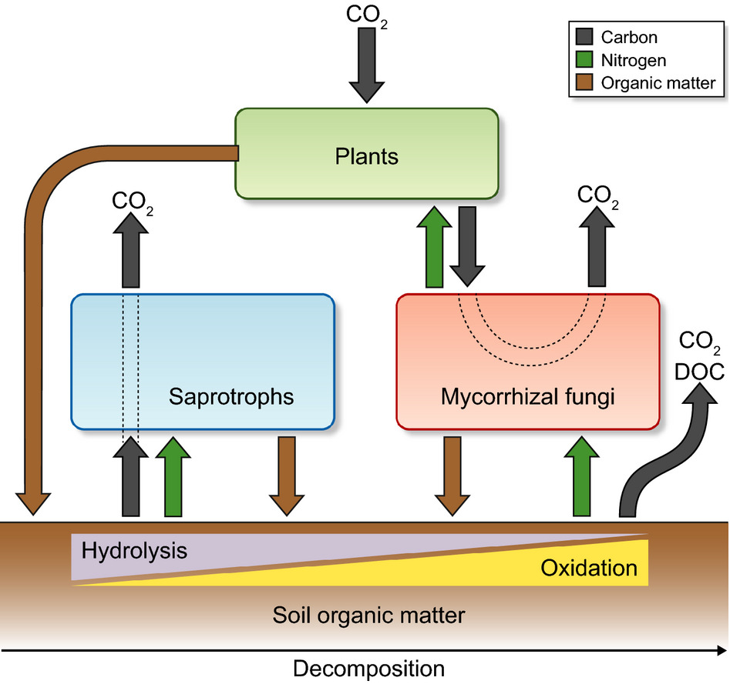
They support our forests
Decomposers (saprotrophs) are essential to carbon and nutrient cycling and the formation and stabilisation of soil aggregates in forest ecosystems
Lindahl and Tunlid (2014)
@RowenaCHill

Slide 7
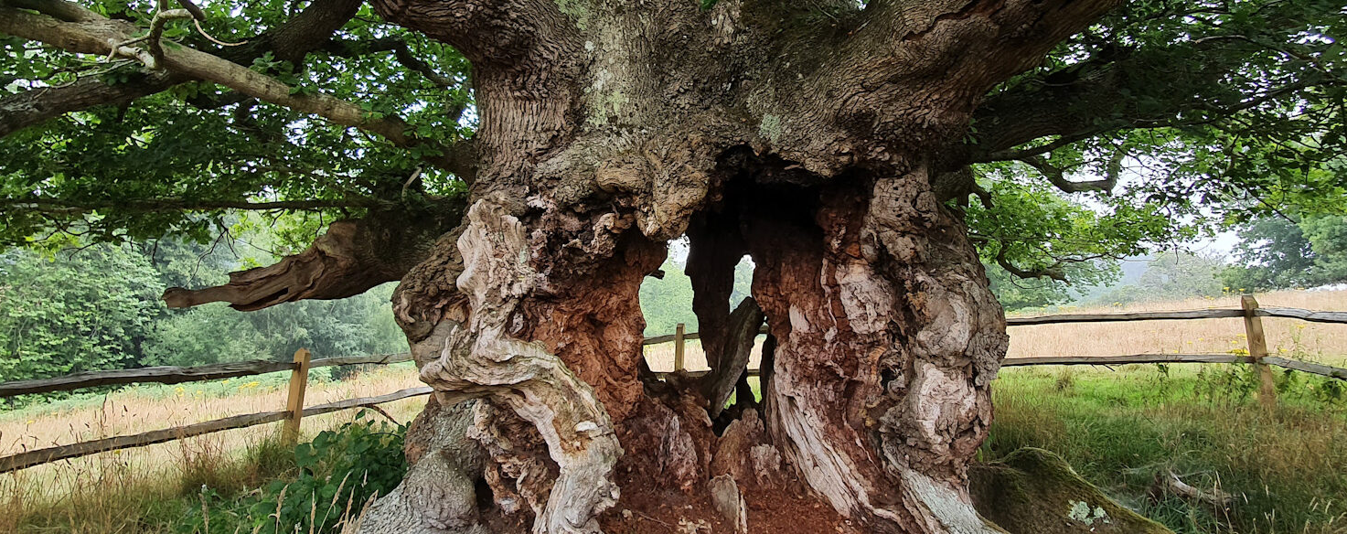
They support our forests
https://foreverfungi.co.uk/oakfungisurvey/
@RowenaCHill

Slide 8
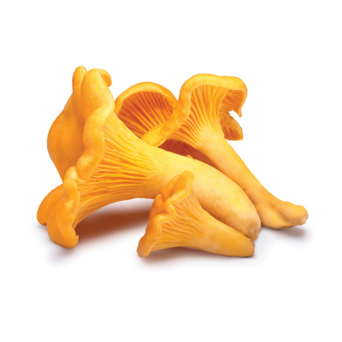
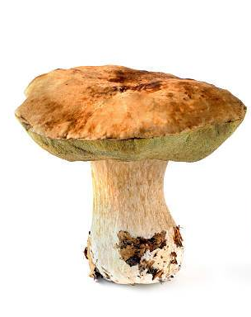
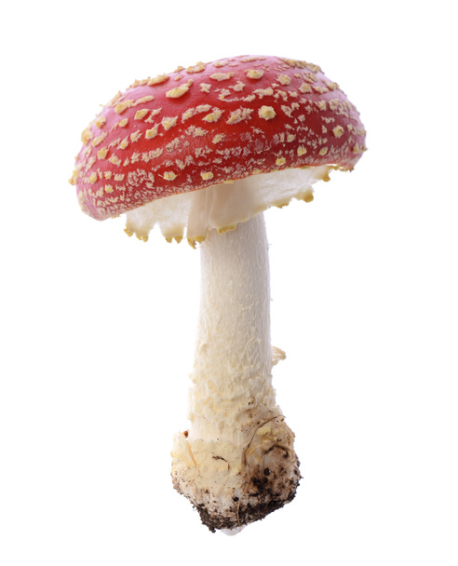
They support our forests
*
Decomposers (saprotrophs) are essential to carbon and nutrient cycling and the formation and stabilisation of soil aggregates in forest ecosystems
*
Lindahl and Tunlid (2014)
@RowenaCHill

Slide 9
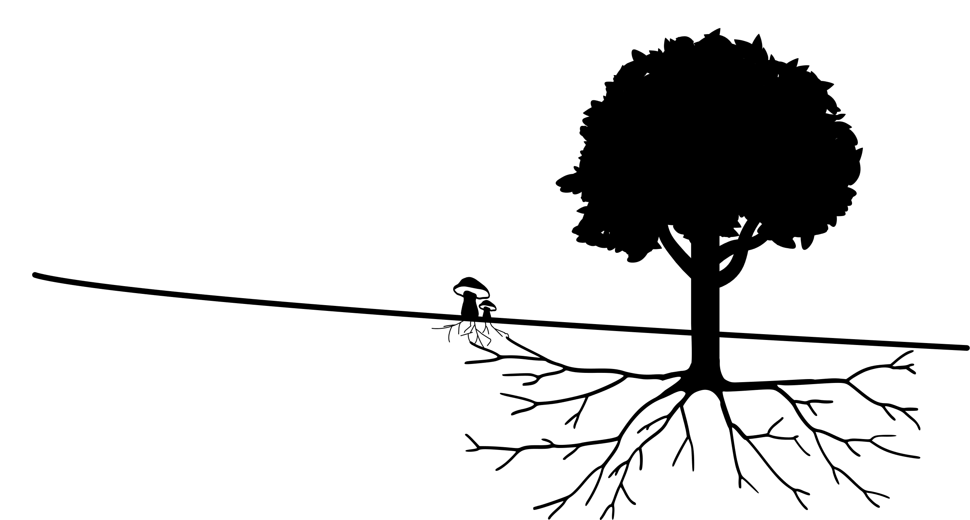
> 80% of plant species have mycorrhizal associations
van der Heijden et al. (2015)
“…most of the stored carbon in boreal forested islands in Sweden is in fact derived from mycorrhizal mycelium rather than from plant litter.”
Clemmensen et al. (2013)
@RowenaCHill

Slide 10
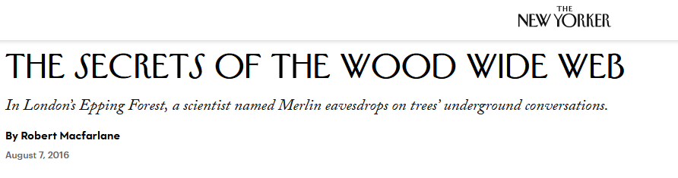
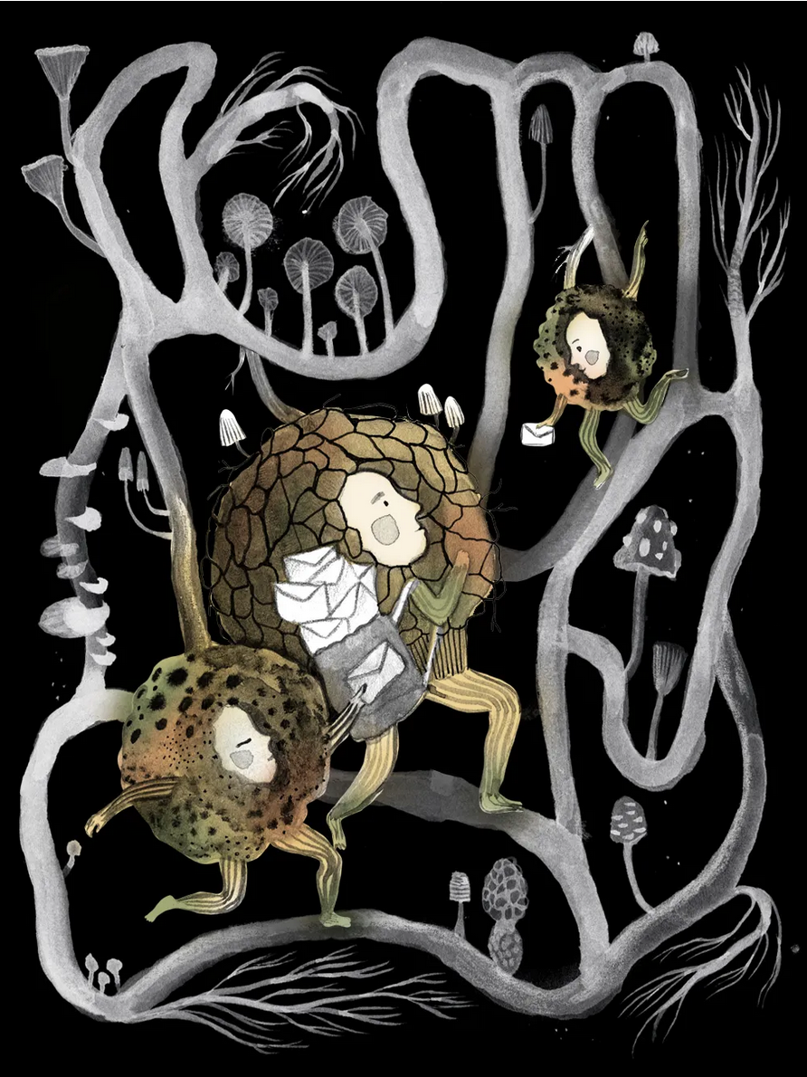
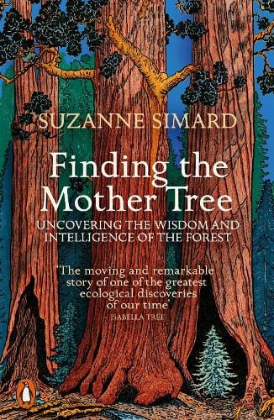
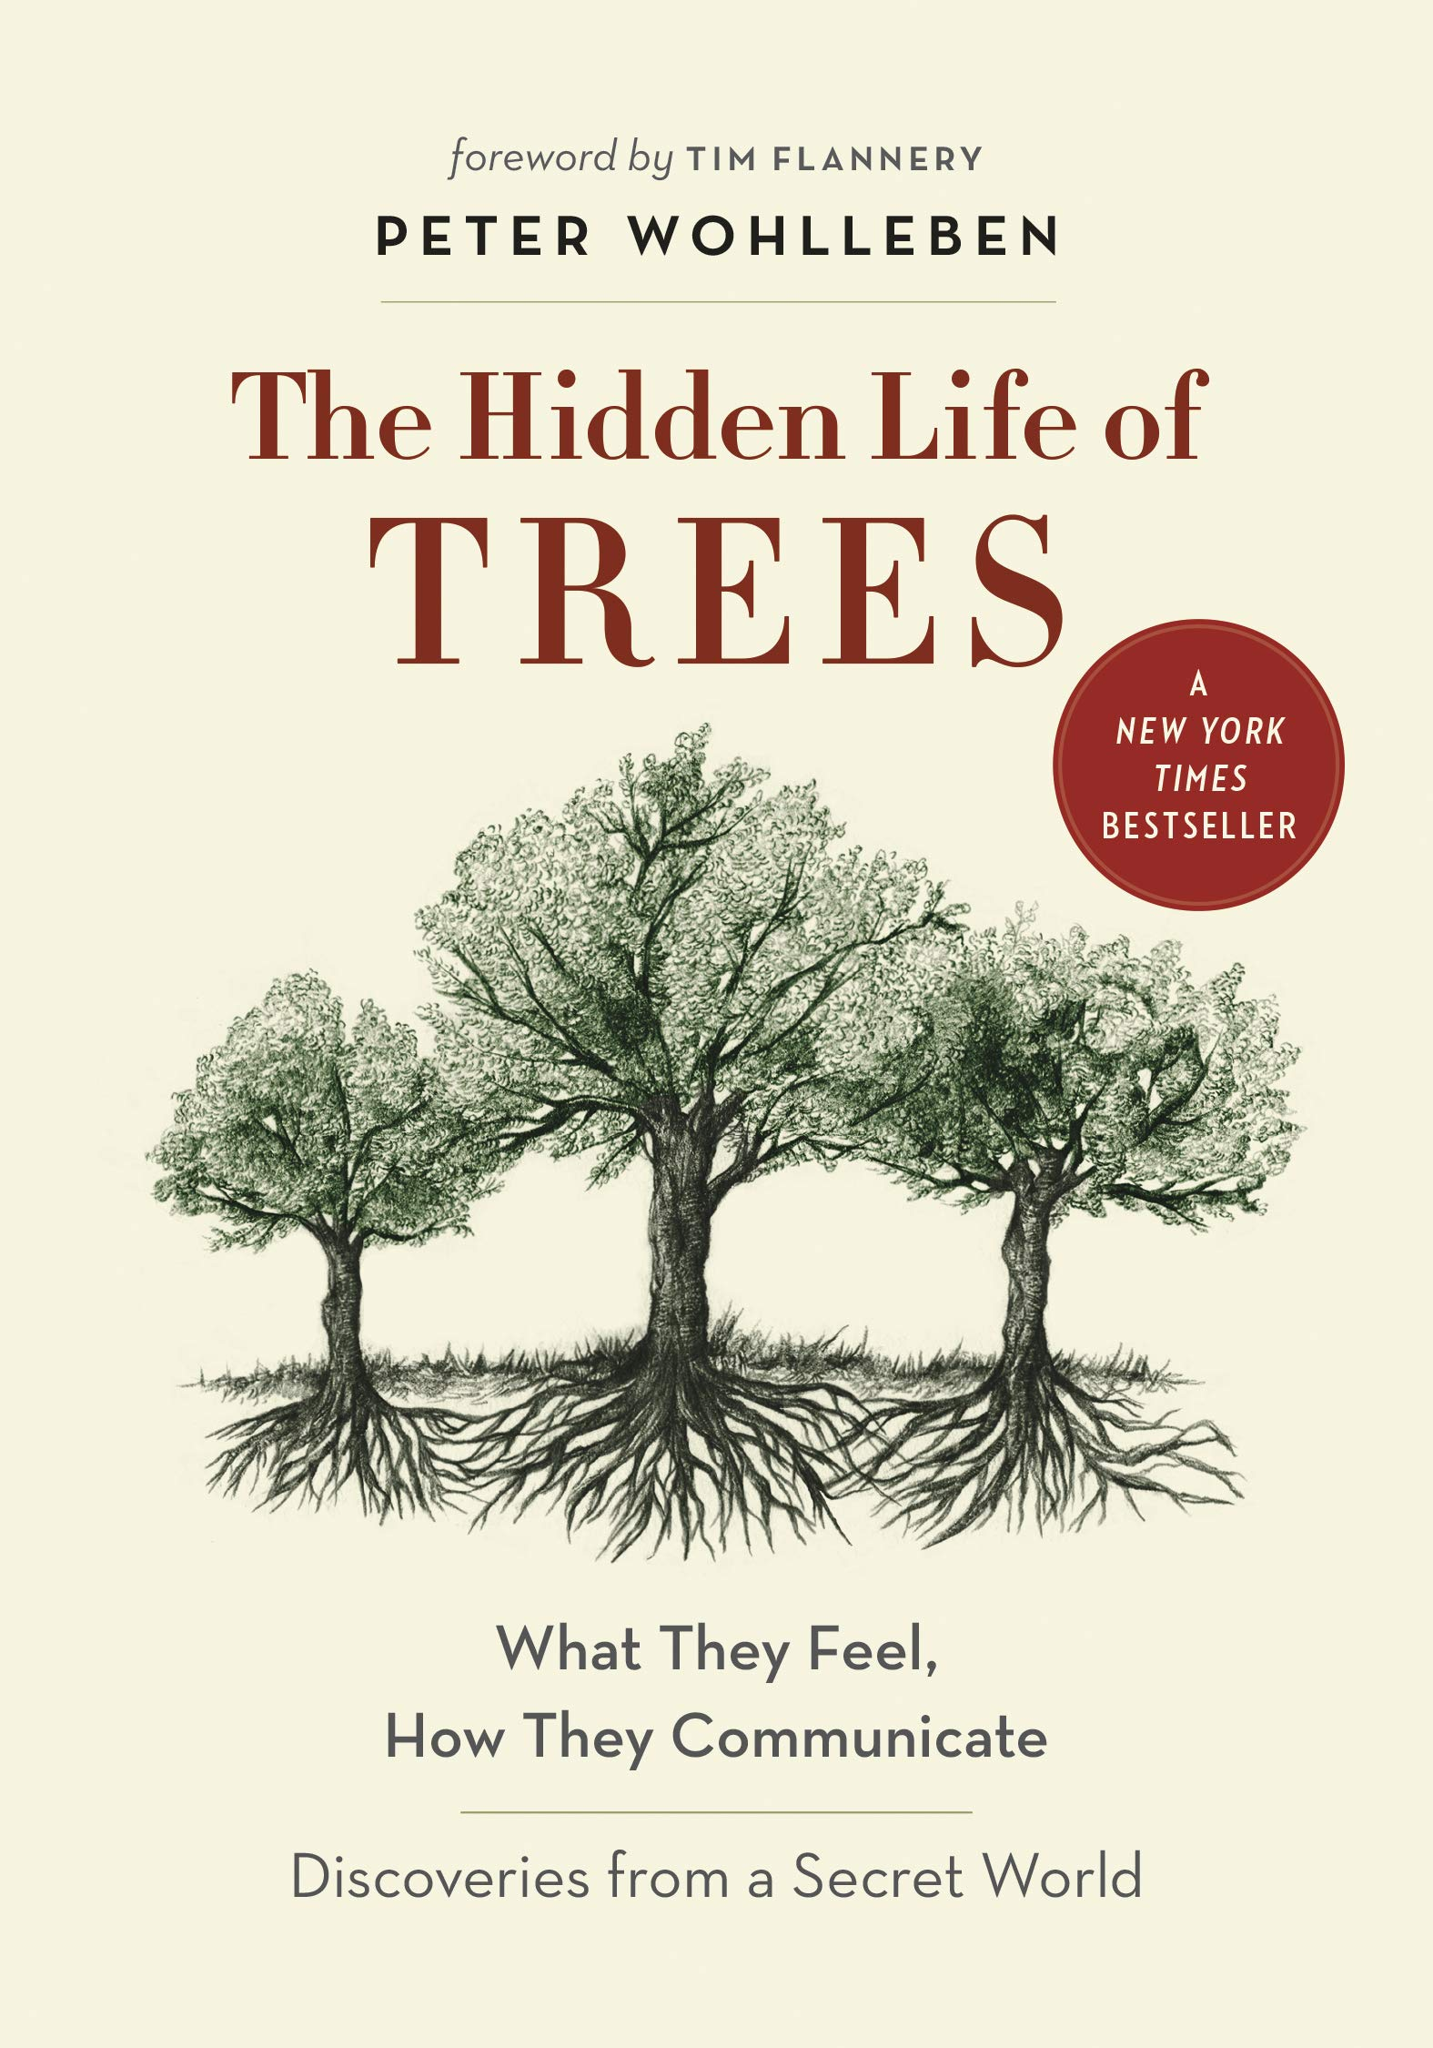
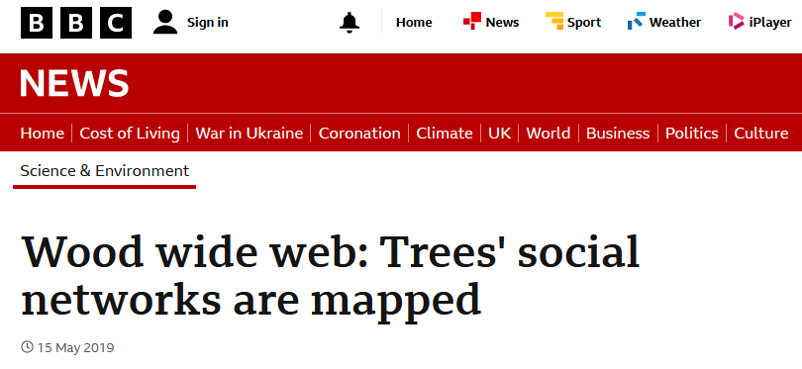
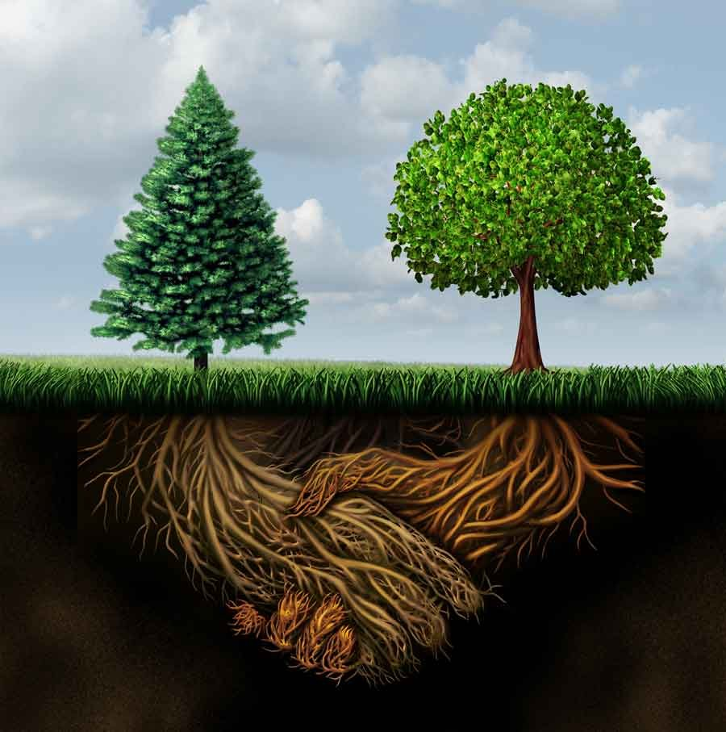
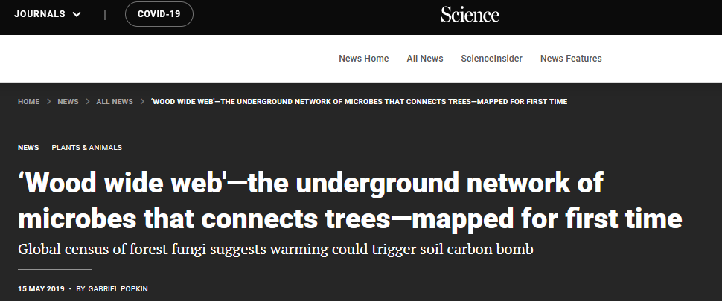
@RowenaCHill

Slide 11
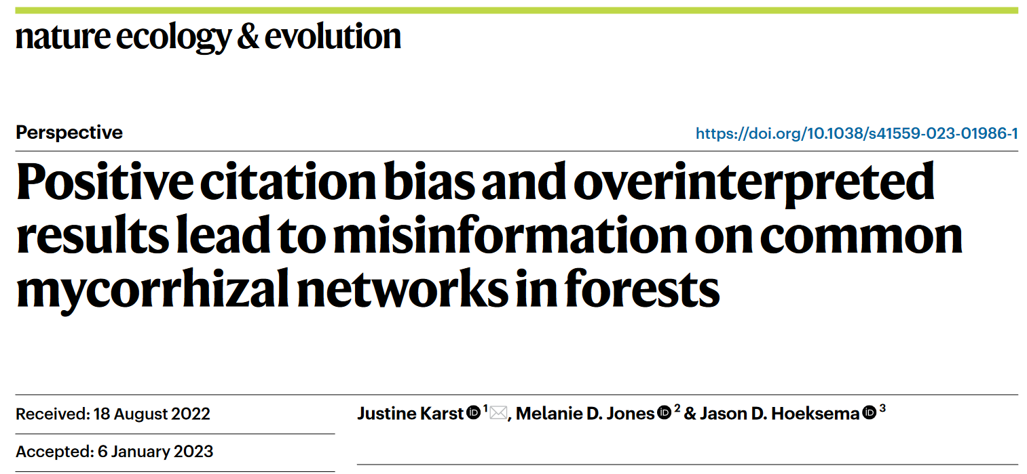
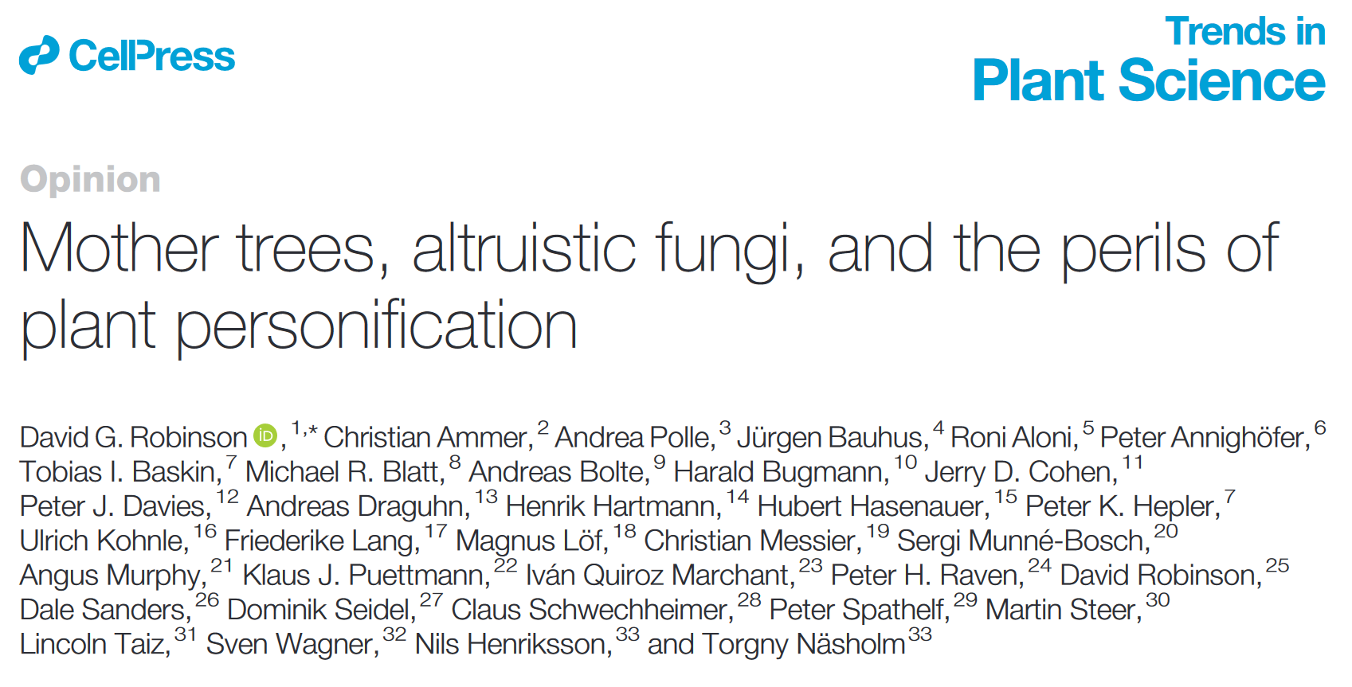
@RowenaCHill

Slide 12
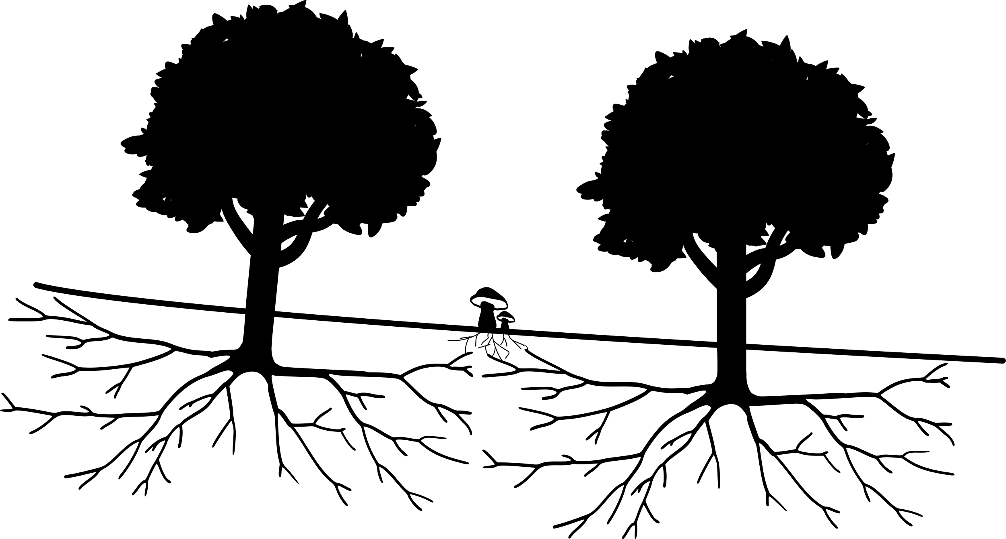
???
“The claim that mature trees preferentially send resources and defence signals to offspring through [mycorrhizal fungi] has no peer-reviewed, published evidence.”
Karst et al. 2023
@RowenaCHill

Slide 13
???
“[…] transfer from mother trees to seedlings […] would imply a remarkably collaborative fungal behavior, with questionable adaptive benefits, especially to the fungus.”
Henriksson et al. 2023
@RowenaCHill

Slide 14
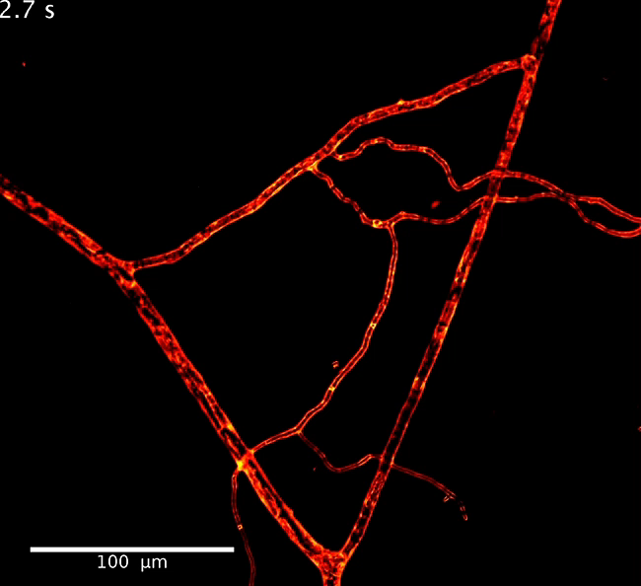
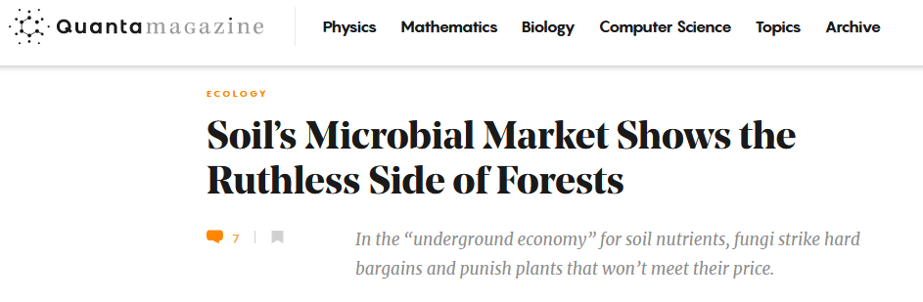
Whiteside et al. 2019
@RowenaCHill

Slide 15
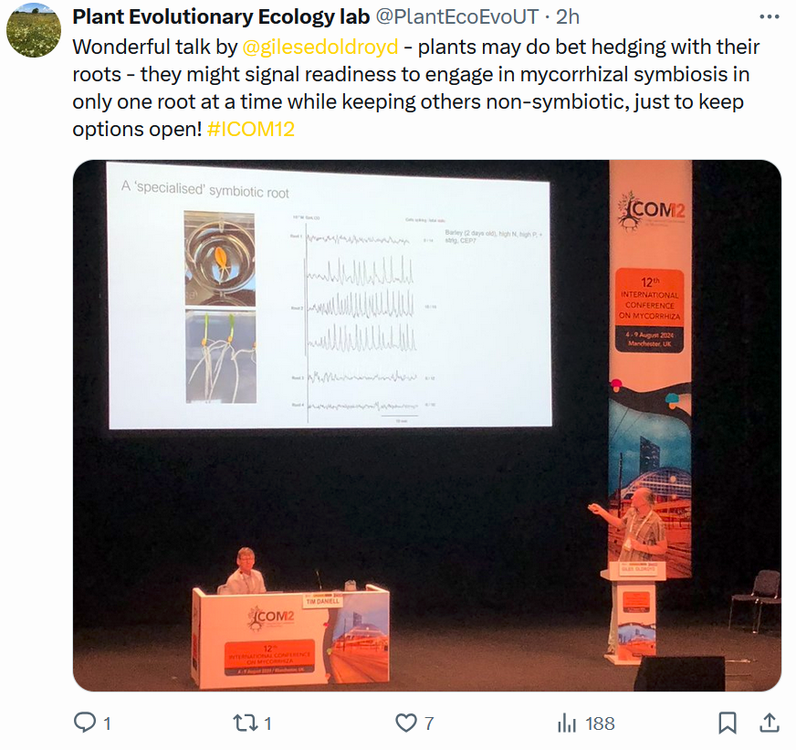
@RowenaCHill

Slide 16
???
@RowenaCHill

Slide 17
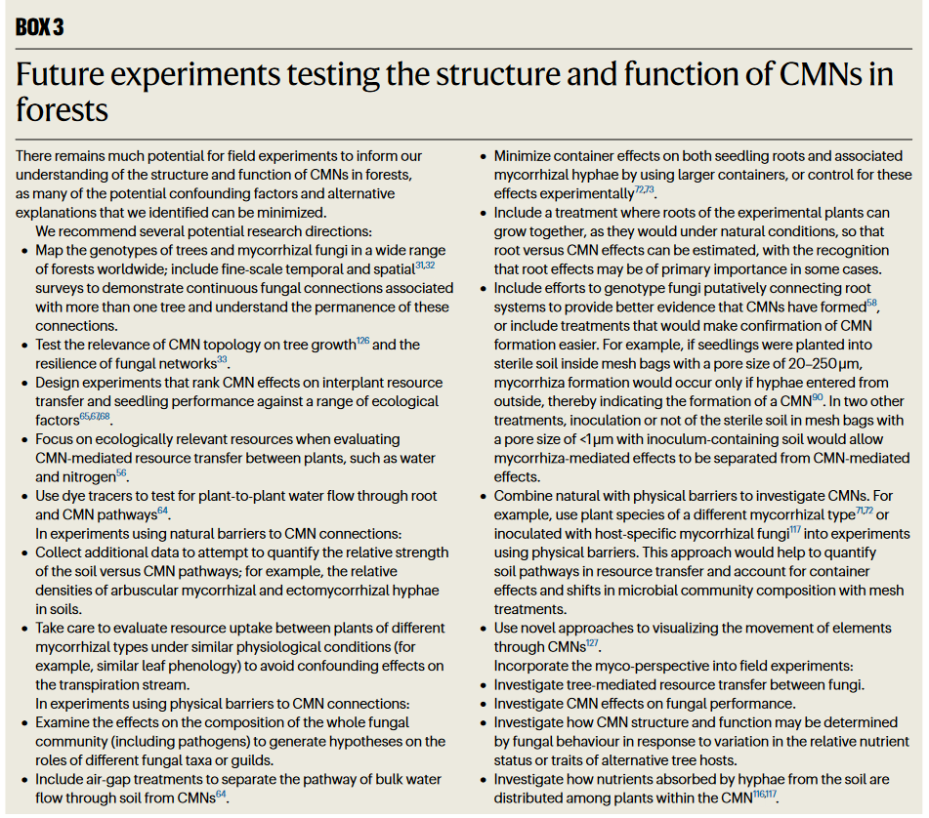
@RowenaCHill

Slide 18
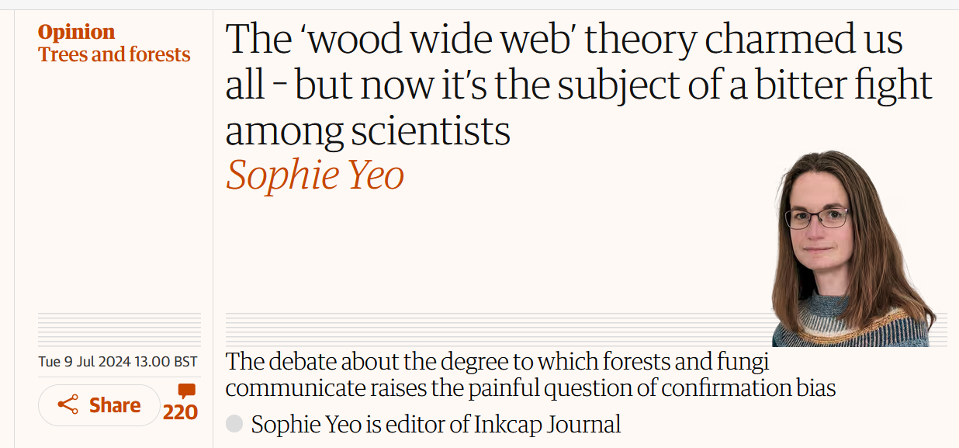
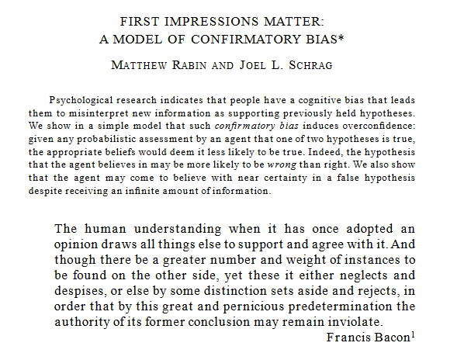
“The explosion of interest comes not from an unaccountable passion for fungal networks but for what the theory implies: that the natural world is not static and cruel, but rather a living community governed by the same moral principles as our own.”
@RowenaCHill

Slide 19
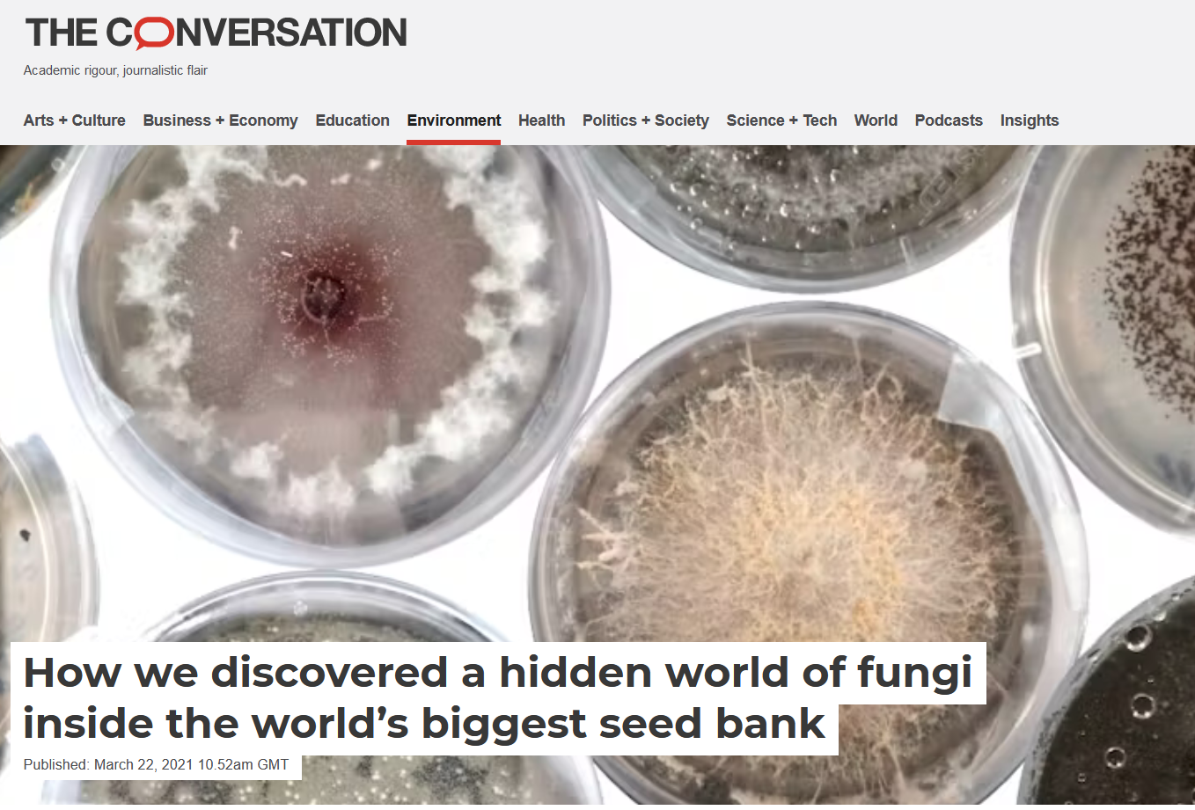
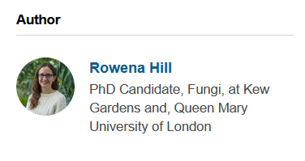
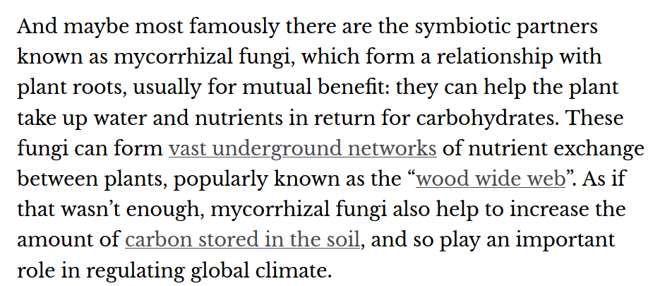
@RowenaCHill

Slide 20

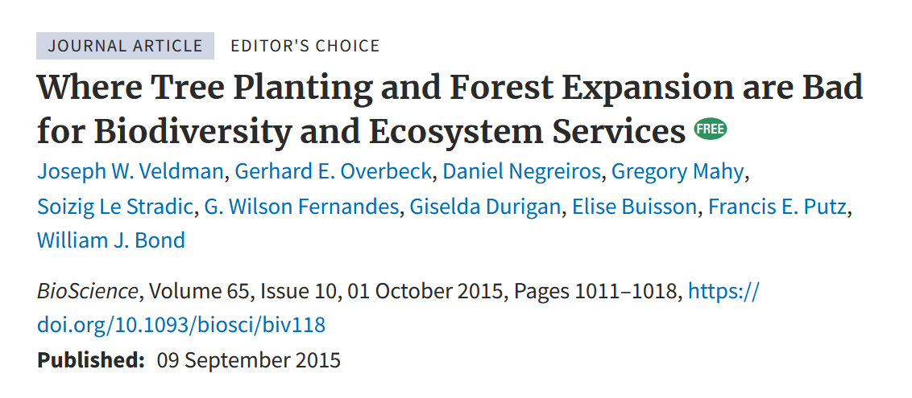
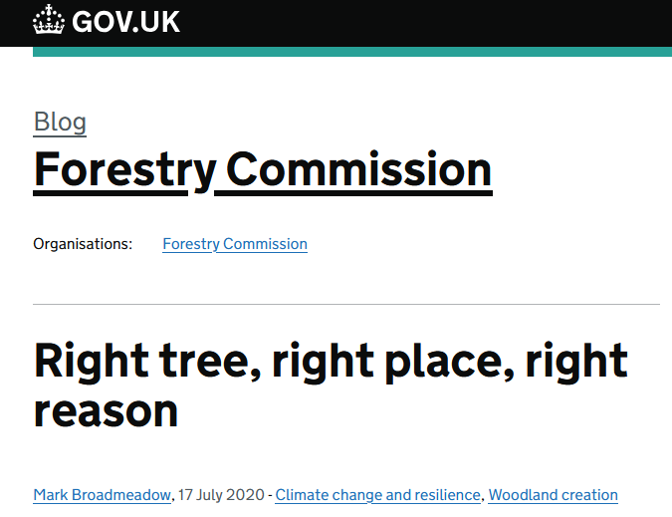
Why does it matter if it means that people are more invested in nature and fungi and it makes them want to protect forests?
By increasing interest and popularity, there was more funding given and the study area grew. Maybe ‘the ends justify the means’.
Facts matter – governments use them (and the attention they attract) to inform policy
@RowenaCHill

Slide 21
What can we learn?
Scientists and science communicators have the responsibility to get important work out there, but also the responsibility to do their best to make sure it’s not misconstrued (and try not to get carried away with messaging)
Scientists are human, not perfectly rational beings
Try and be open to changing our minds
The ‘wood wide web’ is nuanced, but mycorrhizal fungi are still fascinating!
@RowenaCHill

Slide 22
Thanks for listening!
Check out these slides @ https://github.com/Rowena-h/Presentations
@RowenaCHill

